Slide 1

CLOUD BURST IDENTIFICATION AND WEATHER ANOMALY DETECTION
By
24B81A67H6 – R. Sri Harini
24B81A67J3 – V. Uday Durga
24B81A67J5 – P. Varshini
Project Supervisor : Dr.Yasmeen Mam

Slide 2
ABSTRACT
Extreme weather like cloud bursts is a huge problem lately. Our project, Cloud Burst Identification and Weather Anomaly Analysis, tracks these events using a data-driven approach instead of IoT sensors. We use Python and SQL to monitor rainfall, temperature, and humidity. If rainfall hits a specific threshold, the system flags it as a cloud burst. We’ve also added 7-day trend analysis, heatmaps, and an automatic PDF report generator. Our web dashboard even changes color based on alert levels to make monitoring simple and visual!
Keywords
Weather Anomaly: Detecting unusual climatic shifts.
Threshold Identification: Spotting cloud bursts via rainfall limits.
Data Analysis: Processing trends using Python & SQL.
Visualization: Heatmaps and automated PDF reporting.
Risk Zoning: Mapping geographical weather risks.

Slide 3
INTRODUCTION
Our project, Cloud Burst Identification and Weather Anomaly Analysis, monitors these events using a simple, data-driven approach. Instead of using expensive sensors or ML, we use Python and SQL to analyze rainfall, temperature, and humidity. By comparing real-time data against historical thresholds, the system detects anomalies instantly.
We also built a web dashboard with heatmaps and 7-day trends that changes color based on alert levels. It even generates daily PDF reports, making extreme weather tracking easy and accessible for everyone.

Slide 4
LITERATURE SURVEY
⚠ Limitations in Existing Systems:
Focus mainly on large-scale forecasting.
Complex meteorological models.
Limited simple real-time academic systems.
Lack of integrated database + visualization approach.

Slide 5
PROBLEM STATEMENT
Weather is becoming more unpredictable, and sudden cloud bursts are causing massive damage like floods and landslides. The main problem is that most current weather systems are either too expensive because they require IoT sensors or too complex because they use Machine Learning. This makes it hard for local authorities to have a simple, low-cost way to monitor risks in real-time. Also, raw weather data is often confusing, so there is a huge need for a system that can automatically detect anomalies and present them through clear alerts and visual reports.

Slide 6
OBJECTIVES
To identify cloud burst events by applying specific rainfall intensity thresholds.
To detect abnormal changes in temperature and humidity by comparing real-time data with historical averages.
To manage and query weather data efficiently using an SQL database for structured analysis.
To visualize weather patterns through 7-day moving averages and heatmaps (District vs. Date).
To develop a web-based dashboard using HTML and CSS that provides dynamic, color-coded alerts based on risk levels.
To automate the creation of daily PDF reports that summarize rainfall peaks, anomalies, and risk indexes for better decision-making.

Slide 7
PROPOSED SYSTEM
Our proposed project is a data-driven system that uses Python and SQL to identify cloud bursts by comparing rainfall against specific thresholds. It features a smart web dashboard with color-coded alerts and automated reports to make weather monitoring simple and effective.
Logic-Based Detection: Uses rainfall thresholds and historical averages instead of ML or sensors.
Trend Visualization: Includes 7-day moving averages and district-wise heatmaps to track patterns.
Dynamic Dashboard: An HTML interface that changes color based on real-time alert levels.
Automated Reporting: Generates daily PDF summaries with risk indexes and anomaly data.
Risk Zoning: Uses static maps to highlight areas most prone to extreme weather.

Slide 8
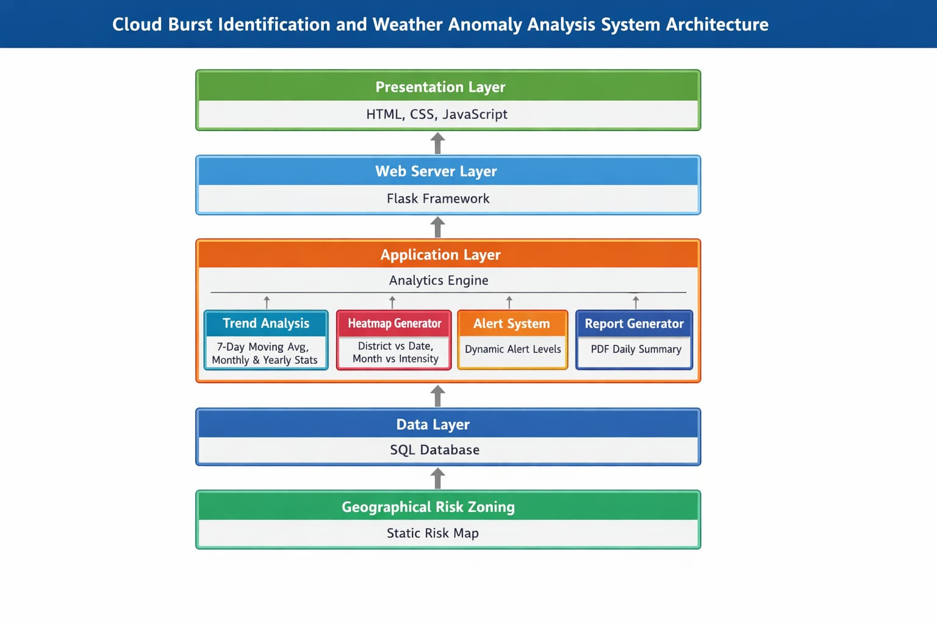

Slide 9
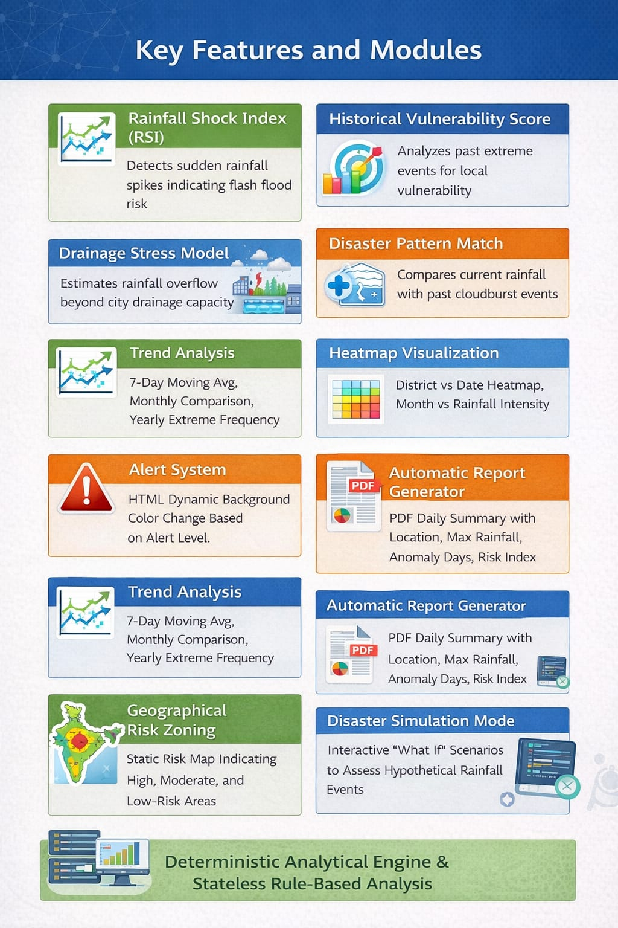

Slide 10
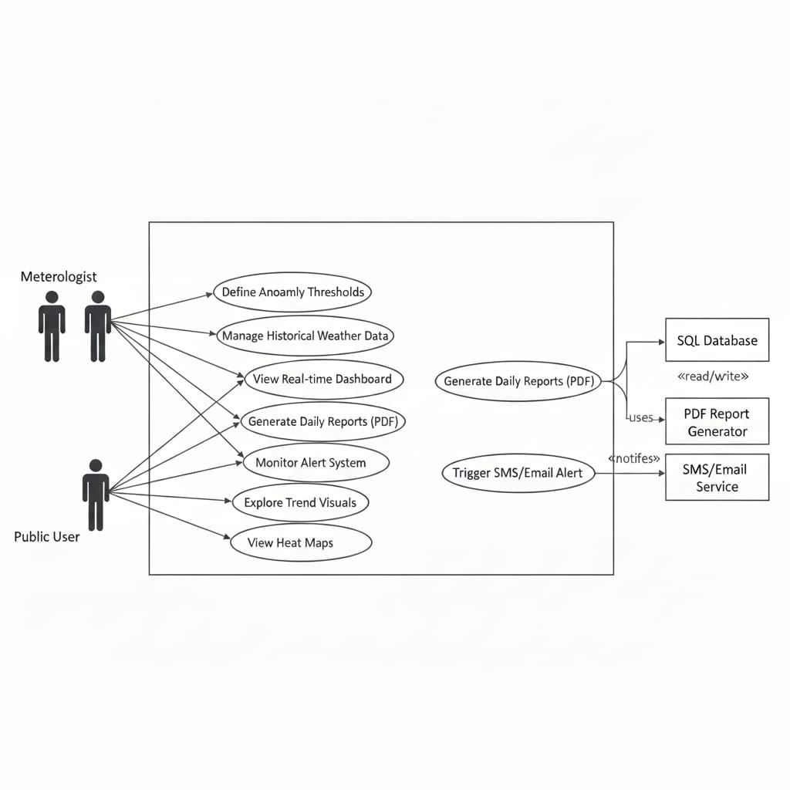
USECASE DIAGRAM

Slide 11
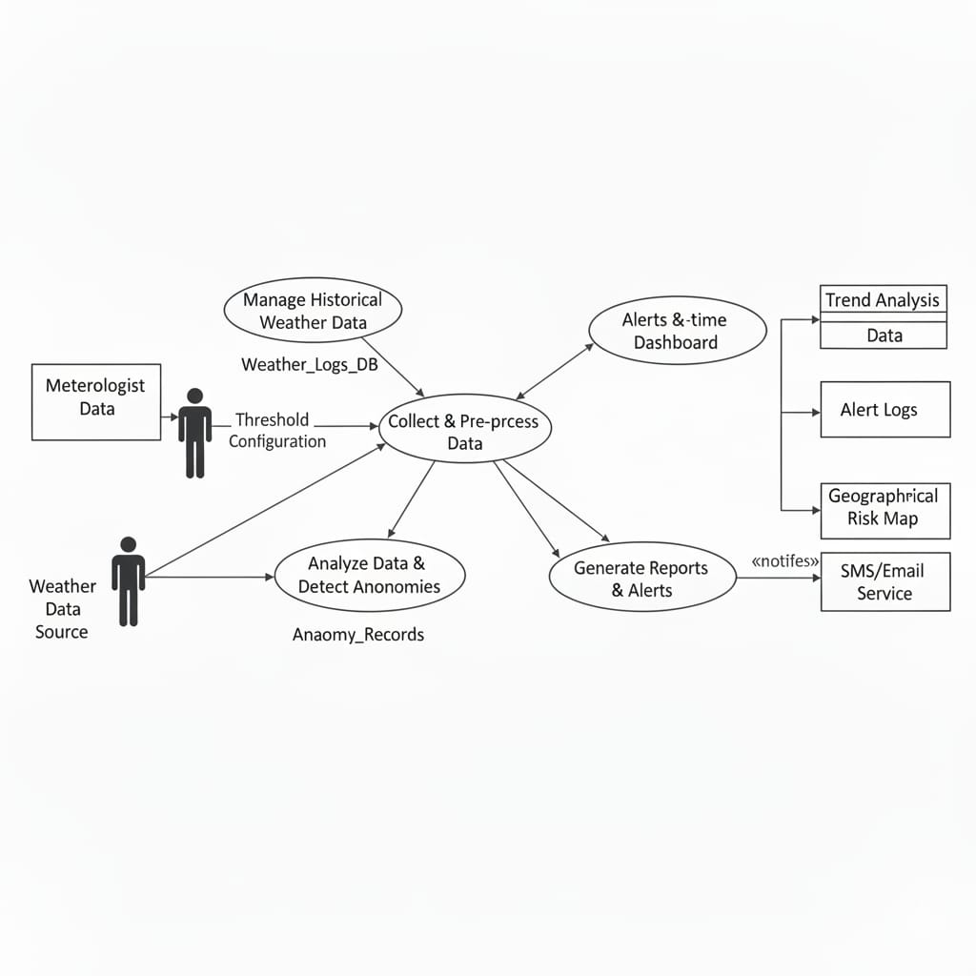
Data Flow Diagram

Slide 12
SOFTWARE REQUIREMENTS
Programming Languages : Python, HTML &CSS
Database Management : MySQL/ SQL
Development Tools (IDEs) : VSCode, Jupyter Notebook
Libraries used:
Pandas & NumPy: For all our data calculations and trend analysis.
Matplotlib / Seaborn: To generate the heat maps and rainfall intensity charts.
FPDF/ReportLab: A simple library we integrated to automatically generate the daily PDF reports.

Slide 13
HARDWARE REQUIREMENTS
Processor: Intel i5 or equivalent AMD processor (Fast enough to run our Python logic and SQL queries).
RAM: 4 GB Minimum (To handle data visualization and the web dashboard smoothly).
Storage: 256 GB HDD/SSD (To store our SQL database and the generated PDF reports).
Operating System: Windows 10/11 or Linux.

Slide 14
THANK YOU

